Slide 1
Travel insurance Data analysis

Slide 2
Objective:
Do ETL : Extract-Transform-Load the dataset and find for me
Some information from this large data. This is form of data mining.
What all information can be achieved by mining this data, would be
brainstormed by the interns
Find key metrics and factors and show the meaningful relationships between attributes.

Slide 3
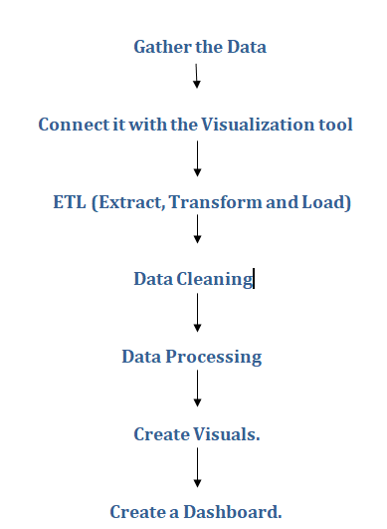
Architecture

Slide 4
Gather Data :
From the Data source , get the data/Download the Data in .csv format.
Go through the Data to get some idea where the Data is missing or where we need to do changes.
Connect with visualization Tool :
Connect the data source to the POWER BI tool / Any other visualization tool by clicking on the IMPORT THE DATA from EXCEL button.
ETL :
Perform ETL ( Extract , Transform and Load)
Once data is imported to POWER BI then we need to perform ETL which is the 1st step of Data analysis.

Slide 5
Data Cleaning:
Once ETL is done, then we move to Data cleaning where we clean the data by removing the black spaces or replacing the 0’s with desired values or any other transformation we need..
This will be done in the POWER QUERY window.
Data modeling:
We create some data models which makes all the tables interconneted.
Data Processing :
Once cleaning is done, we move to DATA Processing, where we can create New columns or create some Measures, or any other calculations we need.
Once processing is done, we clink on close and apply in power query window which takes us to the Report view of the POWER BI where we create some visuals and play with Data.

Slide 6
Create some visuals:
Once ETL, data cleaning, and Data processing is done then our data is ready to get visualized.
We make visuals in the Report view of the tool. Even we can transform the data while we work with the visuals.
Once we create the visuals with respect to the problem statement, then we are ready to create a Dashboard.
Visualizing the Data:
*We rearrange the Visuals and charts to look like a dashboard.
We apply some Slicers , which gives us the desired data.
Based on the graphs or charts we prepared, we get some insights / suggestions and recommendations from the data.

Slide 7
Prediction:
* From the given data and Transformed data, we can predict some insights which will be further used to improves sales or decrease the cost for the company.
Once we get all the insights for the questions that we are looking for, we can share the dashboard or publish it directly.

